Slide 1
Projective Geometry & Homography
Chul Min Yeum
Assistant Professor
Civil and Environmental Engineering
University of Waterloo, Canada
CIVE 497 – CIVE 700: Smart Structure Technology
Last updated: 2019-12-26

Slide 2

ON 3D-CameraMeasure App
Android: https://play.google.com/store/apps/details?id=com.potatotree.on3dcamerameasure

Slide 3
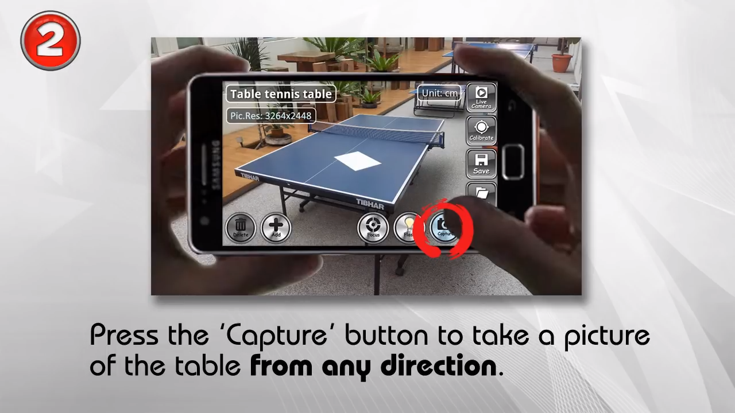
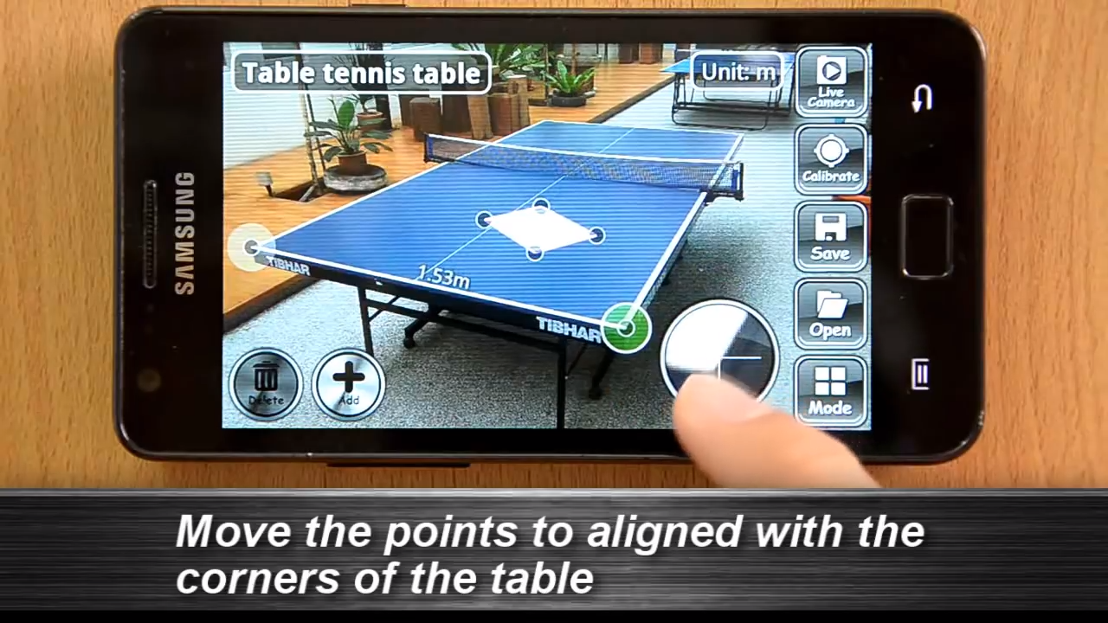
Measurement Demo

Slide 4

Measurement Demo (Continue)

Slide 5
Reference
We will study this topic using
ECE 661: Computer Vision (by Avinash Kak)
Lecture 2: World 2D: Representing and Manipulating Points, Lines And Conics Using Homogeneous Coordinates
Lecture 3: World 2D: Projective Transformations and Transformation Groups
Lecture 4: Characterization of Distortions Caused by Projective Imaging and the Principle of Point/Line Duality
Lecture 5: Estimating a Plane-to-Plane Homography with Angle-to-Angle and Point-to-Point Correspondences
Course website: https://engineering.purdue.edu/kak/computervision/ECE661Folder/

Slide 6
Lecture 2: World 2D: Representing and Manipulating Points, Lines And Conics Using Homogeneous Coordinates

Slide 7
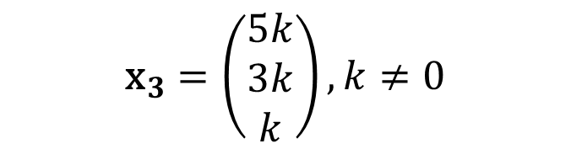
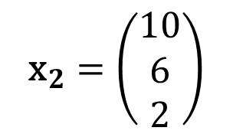
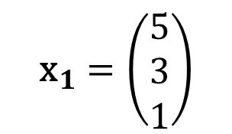
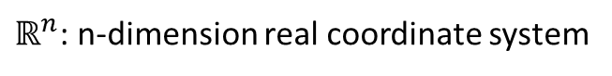
2-1: Point in the Homogeneous Coordinate
An arbitrary homogeneous vector representative of a point is of the form $\text{x}={\left(x_{1},x_{2},x_{3}\right)}^{T}$, representing the point ${\left(x_{1}/x_{3},x_{2}/x_{3}\right)}^{T} \text{in} ℝ^{2}$.
$${\text{x}}_{1}=\left(\begin{matrix}5 \\ 3 \\ 1\end{matrix}\right)$$
$${\text{x}}_{2}=\left(\begin{matrix}10 \\ 6 \\ 2\end{matrix}\right)$$
$${\text{x}}_{3}=\left(\begin{matrix}5k \\ 3k \\ k\end{matrix}\right),k≠0$$
Example)
up to a scale
${\text{x}}_{1},$ ${\text{x}}_{2}$, and ${\text{x}}_{3}$ indicate the same point of (5, 3) in $ℝ^{2}$
$ℝ^{n}$: n-dimension real coordinate system
Notes:
Euclidean space: https://en.wikipedia.org/wiki/Euclidean_space
“ X1 is equal to X3 up to scale”

Slide 8

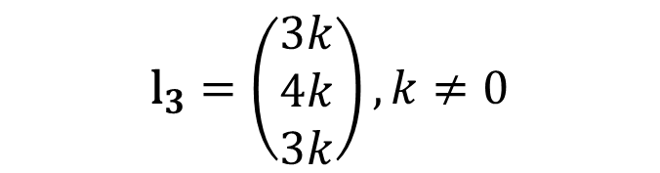

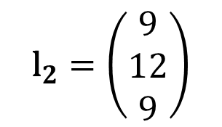
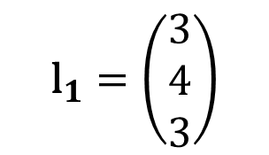

2-1: Line in the Homogeneous Coordinate (HC)
$$ax+by+c=0$$
$$\text{l}={\left(a,b,c\right)}^{⊺}$$
Line equation in $ℝ^{2}$
Line representation in HC
$${\text{l}}_{1}=\left(\begin{matrix}3 \\ 4 \\ 3\end{matrix}\right)$$
$${\text{l}}_{2}=\left(\begin{matrix}9 \\ 12 \\ 9\end{matrix}\right)$$
$${\text{l}}_{3}=\left(\begin{matrix}3k \\ 4k \\ 3k\end{matrix}\right),k≠0$$
Example)
${\text{x}}_{1},$ ${\text{x}}_{2}$, and ${\text{x}}_{3}$ indicate the same line of $3x+4y+3=0$ in $ℝ^{2}$

Slide 9
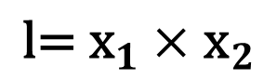

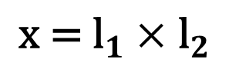
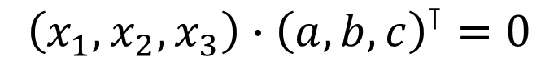
2-1: Points and Lines in the Homogeneous Coordinate (HC)
$$ax+by+c=0$$
$${\left(x_{1},x_{2},x_{3}\right)∙\left(a,b,c\right)}^{⊺}=0$$
The point $\text{x}$ lies on the line $\text{l}$ if and only if $\text{x}{\text{l}}^{⊺}$ =$\text{l}{\text{x}}^{⊺}$= 0.
Given any two lines ${\text{l}}_{1}=(a_{1},b_{1},c_{1})$ and ${\text{l}}_{1}=\left(a_{2},b_{2},c_{2}\right)$, the point ($\text{x}$) of intersection of the two lines :
$${\text{x}\text{ = }\text{l}}_{1}×{\text{l}}_{2}$$
Given any two points ${\text{x}}_{1}=(x_{1},y_{1},z_{1})$ and ${\text{x}}_{2}=\left(x_{2},y_{2},z_{2}\right)$, the line ($\text{l}$) that passes through the two points :
$${\text{l}\text{= }\text{x}}_{1}×{\text{x}}_{2}$$

Slide 10
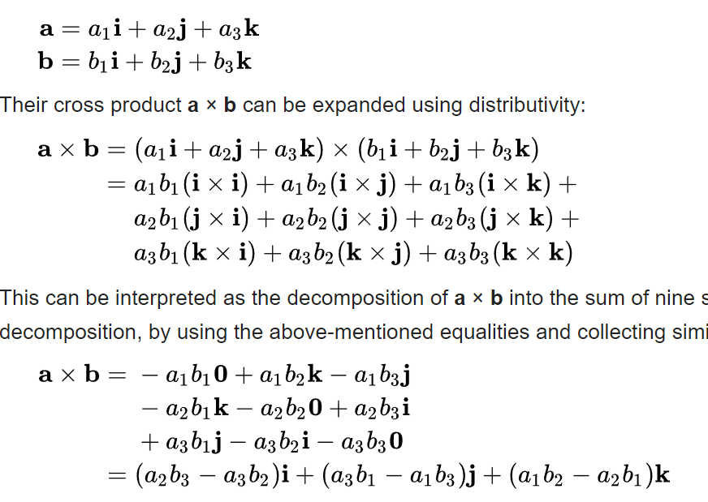
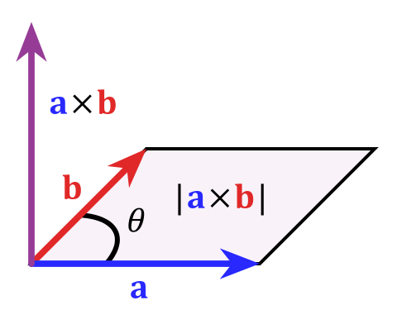
Cross Product
https://en.wikipedia.org/wiki/Cross_product

Slide 11
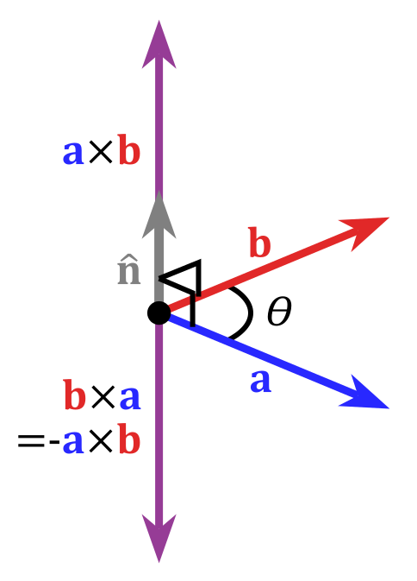
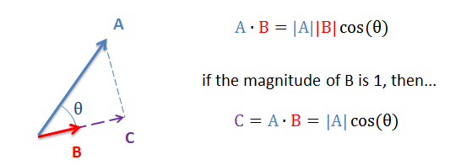
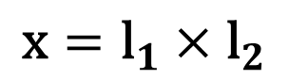
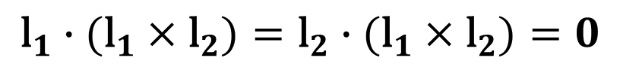
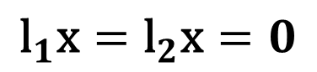
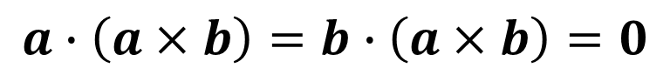
2-2: Prove the Relationship using the Triple Scalar Identity
Dot product
Cross product
$${\text{l}}_{1}\text{x}={\text{l}}_{2}\text{x}=0$$
$$a∙\left(a×b\right)=b∙\left(a×b\right)=0$$
$${\text{l}}_{1}∙({\text{l}}_{1}×{\text{l}}_{2})={\text{l}}_{2}∙({\text{l}}_{1}×{\text{l}}_{2})=0$$
$$\text{x}={\text{l}}_{1}×{\text{l}}_{2}$$
Notes:
https://en.wikipedia.org/wiki/Cross_product

Slide 12
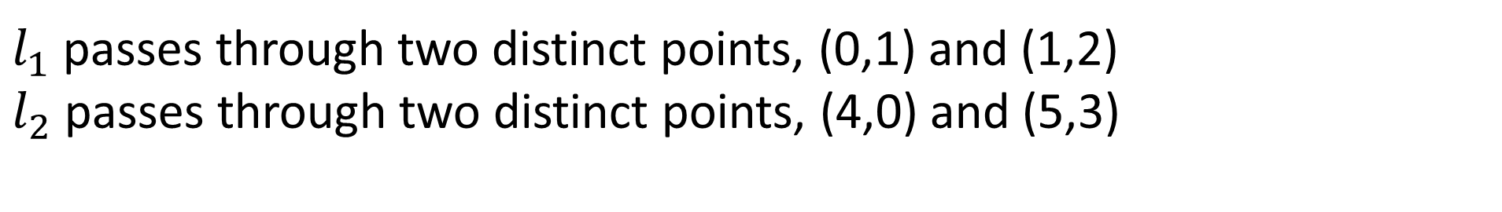
Quiz
Quiz1: Line passes through two points (0,1) and (1,2)
Quiz2: Intersection point ($p_{x}$, $p_{y}$) of two lines $l_{1}$and $l_{2}$
$l_{1}$ passes through two distinct points, (0,1) and (1,2)
$l_{2}$ passes through two distinct points, (4,0) and (5,3)

Slide 13
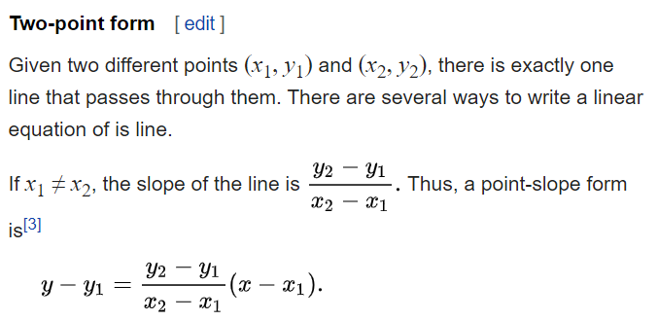
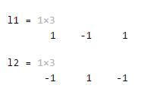

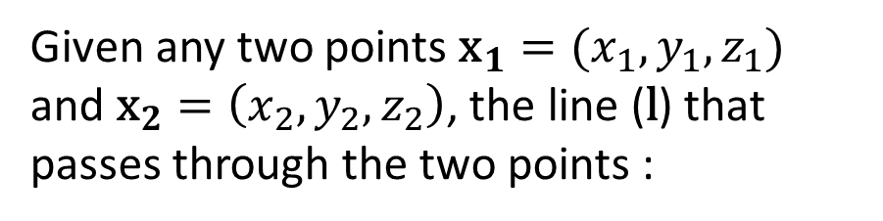
Quiz 1
Given any two points ${\text{x}}_{1}=(x_{1},y_{1},z_{1})$ and ${\text{x}}_{2}=\left(x_{2},y_{2},z_{2}\right)$, the line ($\text{l}$) that passes through the two points :
$${\text{l}\text{= }\text{x}}_{1}×{\text{x}}_{2}$$
pt1 = [0 1]; pt2 = [1 2]; slope = (pt2(2)-pt1(2))/(pt2(1)-pt1(1)); l1 = [slope -1 -slope*pt1(1)+pt1(2)] l2 = cross([pt1 1], [pt2 1])
https://en.wikipedia.org/wiki/Linear_equation

Slide 14
Quiz 2: Graph

Slide 15
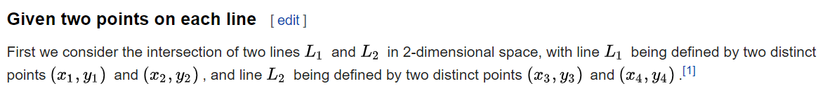
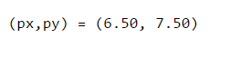
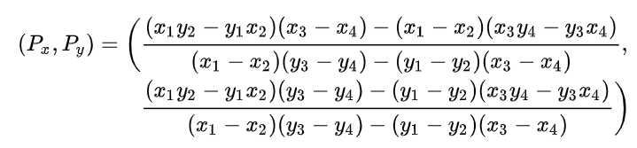
Quiz 2: Method 1
denom = (0-1)*(0-3)-(1-2)*(4-5); numerx = (0*2-1*1)*(4-5)-(0-1)*(4*3-0*3); numery = (0*2-1*1)*(0-3)-(1-2)*(4*3-0*3); px = numerx/denom; py = numery/denom;
https://en.wikipedia.org/wiki/Line%E2%80%93line_intersection

Slide 16
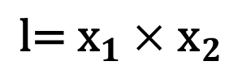
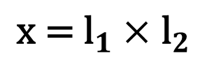
Quiz 2: Method 2
Given any two lines ${\text{l}}_{1}=(a_{1},b_{1},c_{1})$ and ${\text{l}}_{1}=\left(a_{2},b_{2},c_{2}\right)$, the point ($\text{x}$) of intersection of the two lines :
$${\text{x}\text{ = }\text{l}}_{1}×{\text{l}}_{2}$$
Given any two points ${\text{x}}_{1}=(x_{1},y_{1},z_{1})$ and ${\text{x}}_{2}=\left(x_{2},y_{2},z_{2}\right)$, the line ($\text{l}$) that passes through the two points :
$${\text{l}\text{= }\text{x}}_{1}×{\text{x}}_{2}$$
l1 = cross([0,1,1]',[1,2,1]'); l2 = cross([4,0,1]',[5,3,1]'); x = cross(l1,l2); px = x(1)/x(3); py = x(2)/x(3);

Slide 17
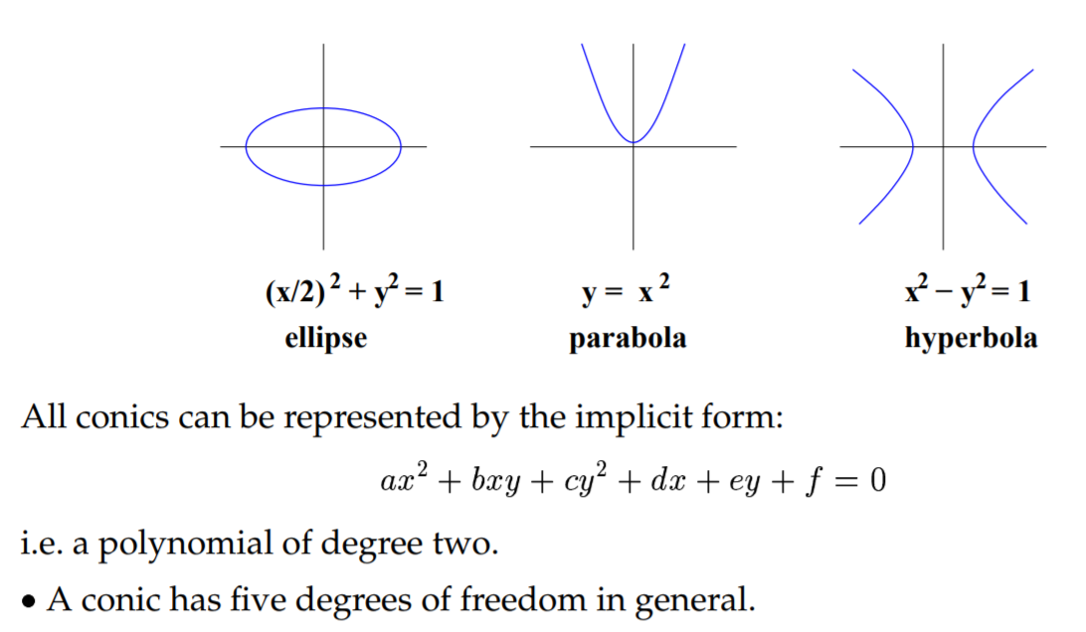
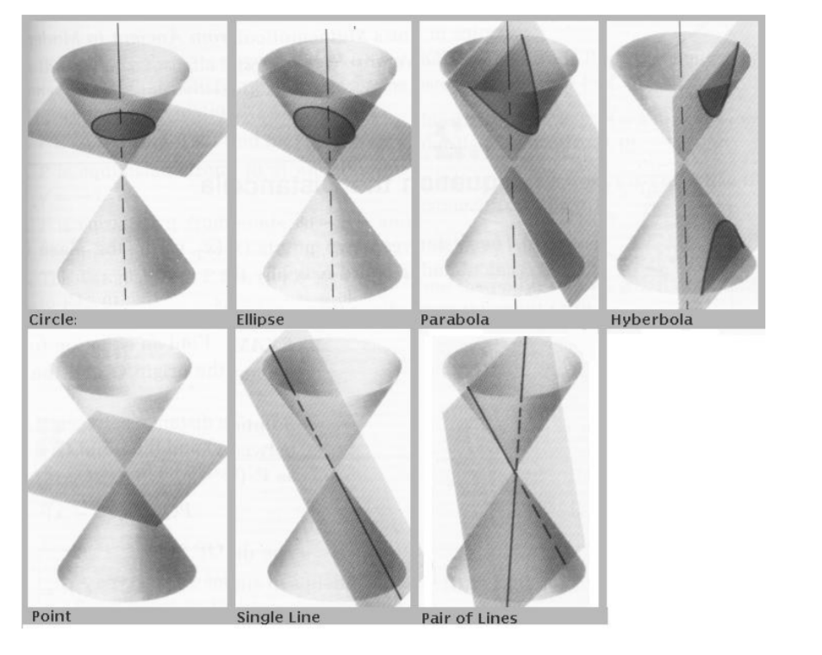
2-3: Conic
$$ax^{2}+b{xy+cy}^{2}+dx+ey+f=0$$
A conic has five degrees of freedom in general
x and y can be represented by the conic equation
Notes:
Implicit function: Implicit function is defined as a relationship between x and y. No distinction can be made between dependent and independent variable.
In other word, x and y can not be separated.
Explicit function: Here, dependent variable is expressed in terms of independent variable. In other word, x and y can be separated.

Slide 18

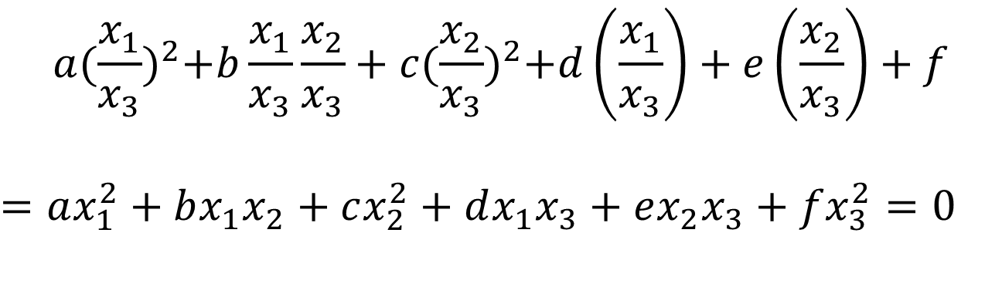

2-3: Conics in HC
$$ax^{2}+bxy+cy^{2}+dx+ey+f=0$$
$\left(x,y\right)$ in $ℝ^{2}$
$$a{(\frac{x_{1}}{x_{3}})}^{2}+b\frac{x_{1}}{x_{3}}\frac{x_{2}}{x_{3}}+c{(\frac{x_{2}}{x_{3}})}^{2}+d\left(\frac{x_{1}}{x_{3}}\right)+e\left(\frac{x_{2}}{x_{3}}\right)+f$$
$$=ax_{1}^{2}+bx_{1}x_{2}+cx_{2}^{2}+dx_{1}x_{3}+ex_{2}x_{3}+fx_{3}^{2}=0$$
$\left(x_{1},x_{2},x_{3}\right)$ in $ℍℂ$

Slide 19
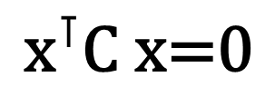
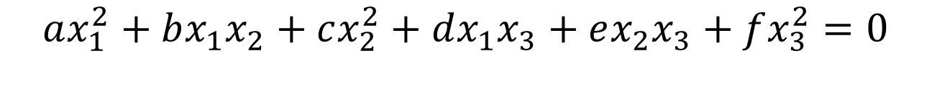
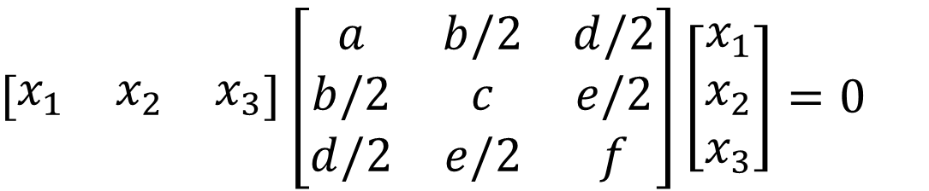


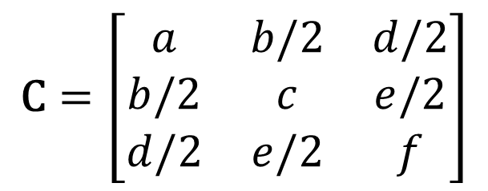
2-3: Conic in HC (Continue)
$$ax_{1}^{2}+bx_{1}x_{2}+cx_{2}^{2}+dx_{1}x_{3}+ex_{2}x_{3}+fx_{3}^{2}=0$$
$\left(x_{1},x_{2},x_{3}\right)$ in $ℍℂ$
$$\left[\begin{matrix}x_{1} & x_{2} & x_{3}\end{matrix}\right]\left[\begin{matrix}a & b/2 & d/2 \\ b/2 & c & e/2 \\ d/2 & e/2 & f\end{matrix}\right]\left[\begin{matrix}x_{1} \\ x_{2} \\ x_{3}\end{matrix}\right]=0$$
$$\text{C}=\left[\begin{matrix}a & b/2 & d/2 \\ b/2 & c & e/2 \\ d/2 & e/2 & f\end{matrix}\right]$$
$${\text{x}}^{⊺}\text{C} \text{x}\text{=0}$$
where
$\text{C}$is the HC representation of a conic

Slide 20
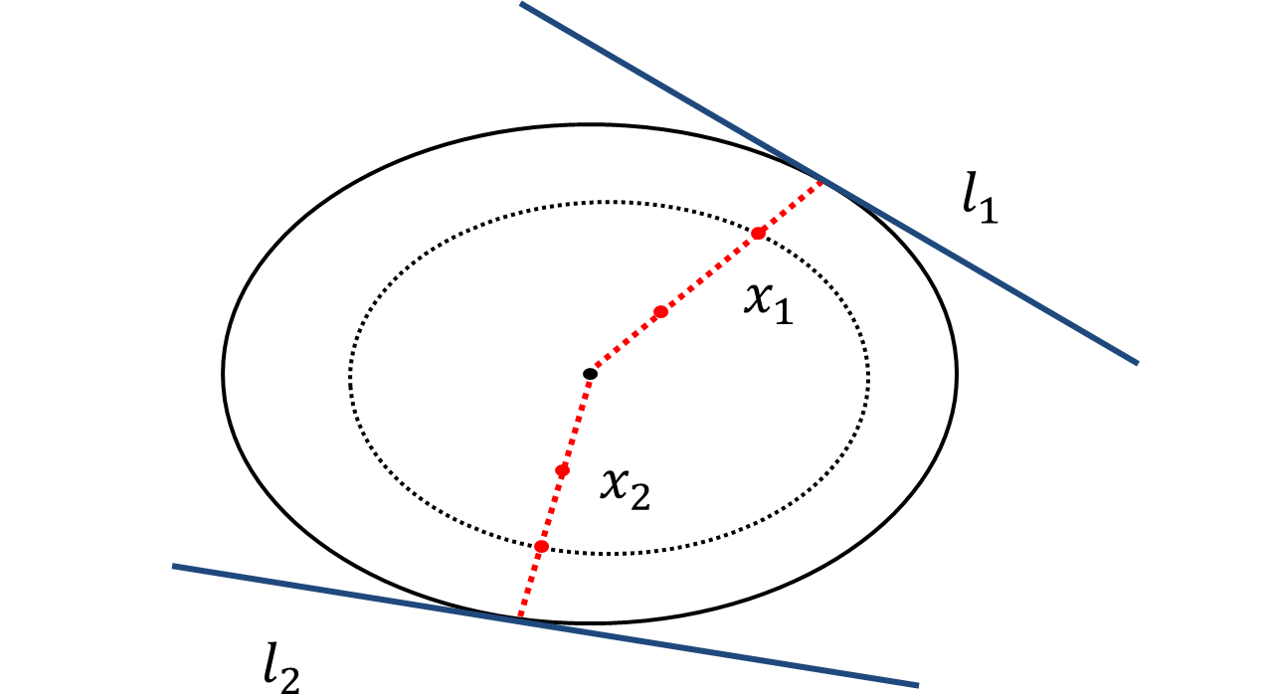
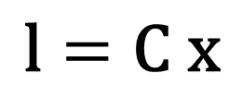
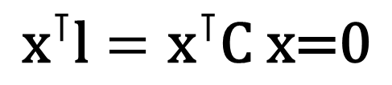
2-4: Conic Property
The HC representation of a conic gives us compact formulas for the tangent lines to a conic.
$${\text{x}}^{⊺}\text{l}={\text{x}}^{⊺}\text{C} \text{x}\text{=0}$$
$$\text{l}=\text{C} \text{x}$$

Slide 21
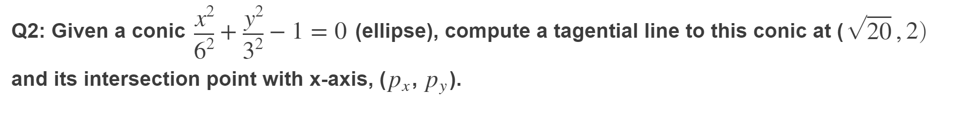
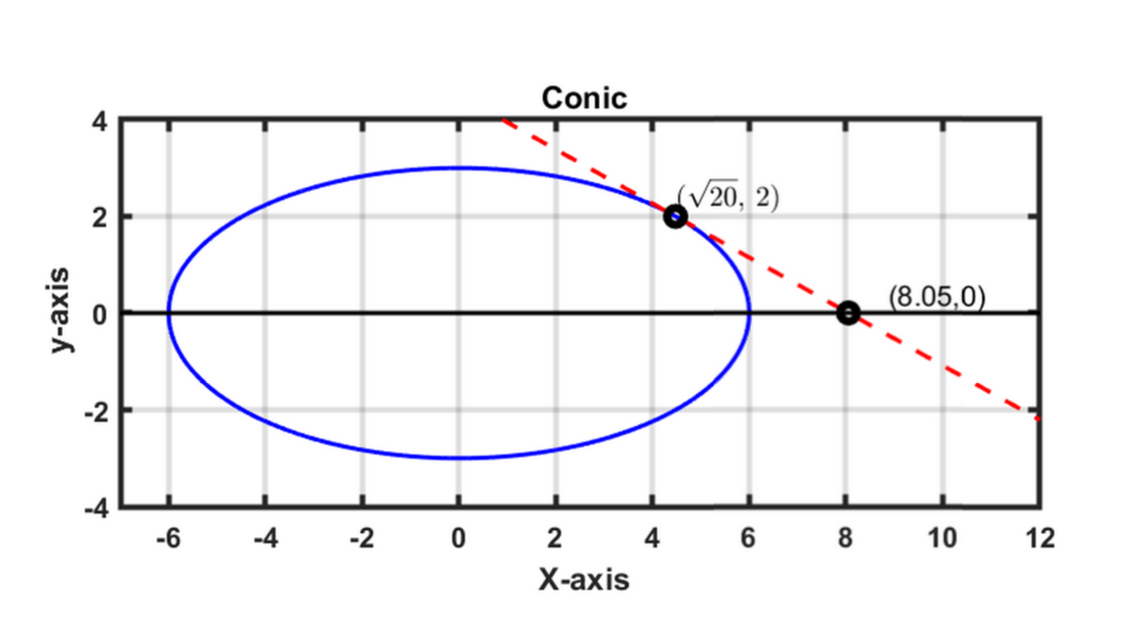
Quiz3

Slide 22
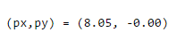
Quiz3: Solution
a = 1/6/6; b = 0; c = 1/3/3; d = 0; e = 0; f = -1; conic = [a b/2 d/2; b/2 c e/2; ... d/2 e/2 f]; lmn = conic*[sqrt(20);2;1] lxa = [0 1 0]; % x-axis: y=0 x = cross(lmn, lxa); px = x(1)/x(3); py = x(2)/x(3);

Slide 23
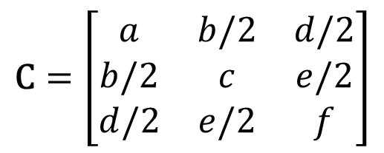
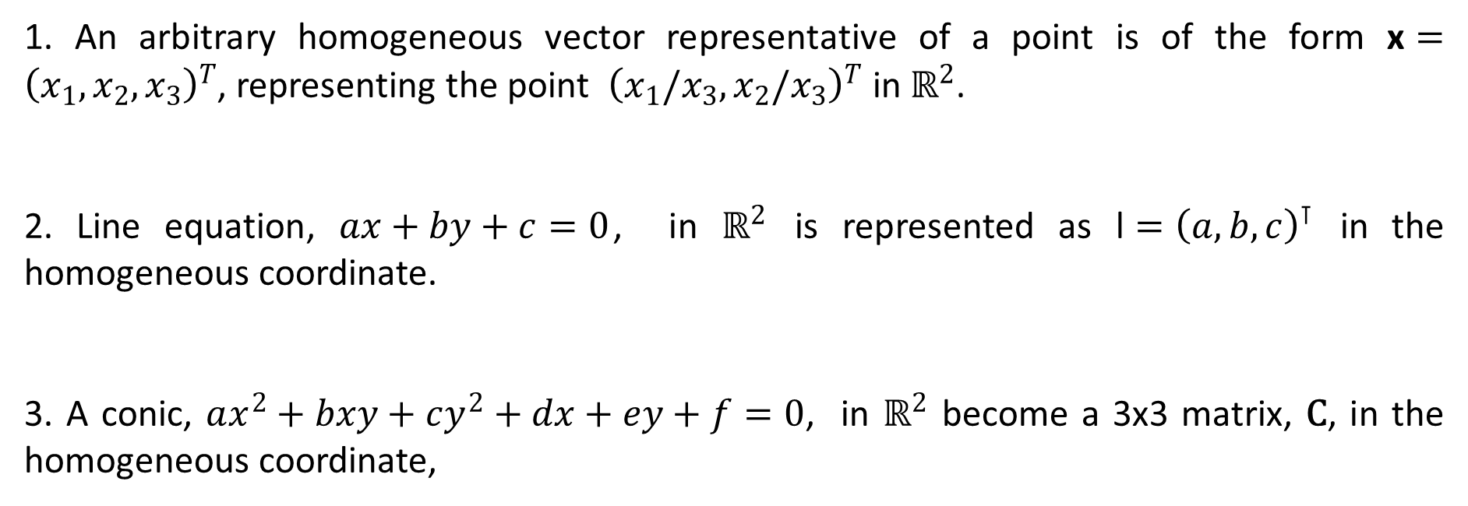
Summary
1. An arbitrary homogeneous vector representative of a point is of the form $\text{x}={\left(x_{1},x_{2},x_{3}\right)}^{T}$, representing the point ${\left(x_{1}/x_{3},x_{2}/x_{3}\right)}^{T} \text{in} ℝ^{2}$.
2. Line equation, $ax+by+c=0$, in $ℝ^{2}$ is represented as $\text{l}={\left(a,b,c\right)}^{⊺}$ in the homogeneous coordinate.
3. A conic, $ax^{2}+bxy+cy^{2}+dx+ey+f=0$, in $ℝ^{2}$ become a 3x3 matrix, $\text{C}$, in the homogeneous coordinate,
$$\text{C}=\left[\begin{matrix}a & b/2 & d/2 \\ b/2 & c & e/2 \\ d/2 & e/2 & f\end{matrix}\right]$$

Slide 24
Lecture 3: World 2D: Projective Transformations and Transformation Groups

Slide 25
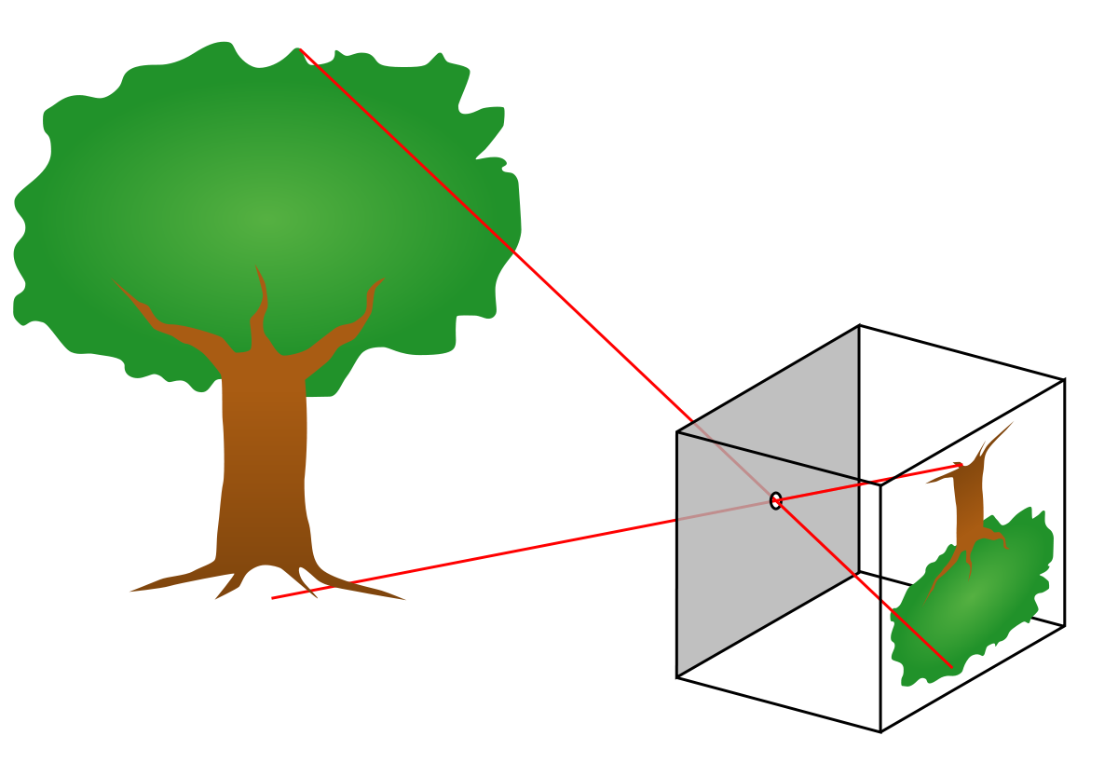
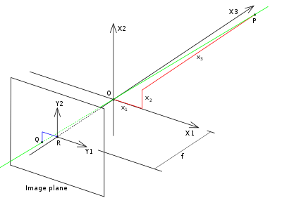
Pinhole Camera Model
https://en.wikipedia.org/wiki/Pinhole_camera_model

Slide 26
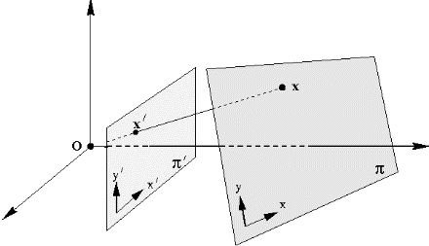
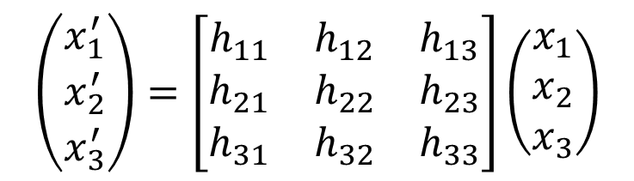
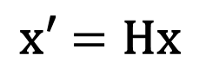
3-1: Projective Transformation
A planar projective transformation (homography) is a linear transformation on homogeneous 3-vectors, the transformation being represented by a non-singular 3x3 matrix H, as in
$$\left(\begin{matrix}x_{1}^{′} \\ x_{2}^{′} \\ x_{3}^{′}\end{matrix}\right)=\left[\begin{matrix}h_{11} & h_{12} & h_{13} \\ h_{21} & h_{22} & h_{23} \\ h_{31} & h_{32} & h_{33}\end{matrix}\right]\left(\begin{matrix}x_{1} \\ x_{2} \\ x_{3}\end{matrix}\right)$$
$$\text{x}\text{′}=\text{Hx}$$
Notes:
Theorem 2.10.

Slide 27
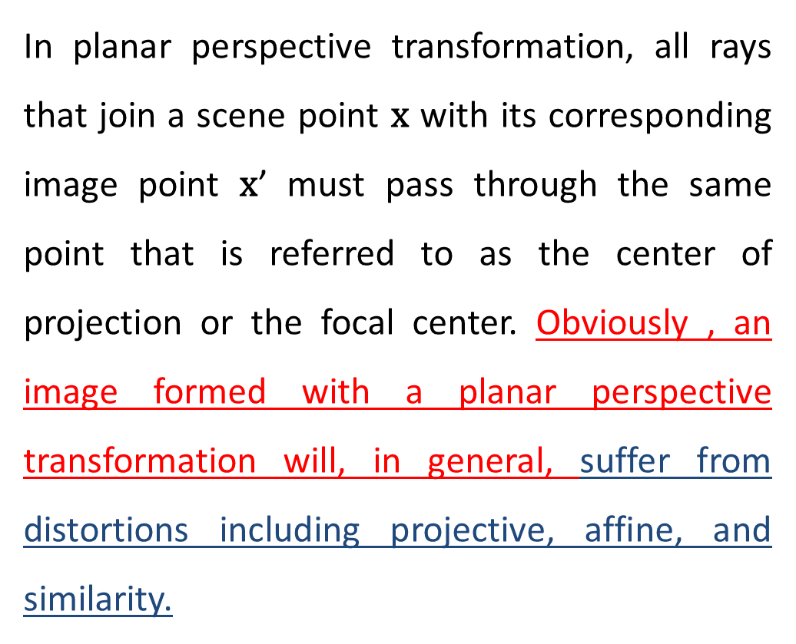
3-1: Projective Transformation (continue)
In planar perspective transformation, all rays that join a scene point $\text{x}$ with its corresponding image point $\text{x}$’ must pass through the same point that is referred to as the center of projection or the focal center. Obviously , an image formed with a planar perspective transformation will, in general, suffer from distortions including projective, affine, and similarity.

Slide 28




3-1: Property of a Homography
It always maps a straight line to a straight line.
$$\text{x}\text{′}=\text{Hx}$$
$${\text{l}\text{′}}^{⊺}\text{x}\text{′}={\text{l}\text{′}}^{⊺}\text{Hx}\text{ =}{\text{(}\text{l}\text{′}}^{⊺}\text{H}\text{)}\text{x}\text{=}\text{lx}\text{=0}$$
$${\text{l}\text{′}}^{⊺}\text{H}\text{=}\text{l}$$
$${\text{l}\text{′=}\text{H}}^{−⊺}\text{l}$$

Slide 29
3-2: Hierarchy of Transformation
Projective group
(correct) A similarity transform is an affine transform.
(incorrect) A projective transform is an affine transform.
(correct) An Euclidean transform is an affine transform.
(correct) An affine transform is an projective transform.
(incorrect) An similarity transform is an Euclidean transform.
subgroup of
Affine group
subgroup of
Similarity group
subgroup of
Euclidean group

Slide 30







3-4: Geometric Transformation (Euclidean Transformation)
Rigid body motions
$$\left(\begin{matrix}x_{1}^{′} \\ x_{2}^{′} \\ x_{3}^{′}\end{matrix}\right)=\left[\begin{matrix}1 & 0 & t_{x} \\ 0 & 1 & t_{y} \\ 0 & 0 & 1\end{matrix}\right]\left(\begin{matrix}x_{1} \\ x_{2} \\ x_{3}\end{matrix}\right)$$
$$\text{x}\text{′}=\text{x}+\text{t}$$
$$\left(\begin{matrix}x_{1}^{′} \\ x_{2}^{′} \\ x_{3}^{′}\end{matrix}\right)=\left[\begin{matrix}cosθ & −sinθ & 0 \\ sinθ & cosθ & 0 \\ 0 & 0 & 1\end{matrix}\right]\left(\begin{matrix}x_{1} \\ x_{2} \\ x_{3}\end{matrix}\right)$$
$$\text{x}\text{′}=\text{Rx}$$
$$\left(\begin{matrix}x_{1}^{′} \\ x_{2}^{′} \\ x_{3}^{′}\end{matrix}\right)=\left[\begin{matrix}cosθ & −sinθ & t_{x} \\ sinθ & cosθ & t_{y} \\ 0 & 0 & 1\end{matrix}\right]\left(\begin{matrix}x_{1} \\ x_{2} \\ x_{3}\end{matrix}\right)$$
See tutorials
$$\text{x}\text{′}=\text{Rx}+\text{t}$$

Slide 31



Example
Translation
Rotation

Slide 32




3-4: Geometric Transformation (Similarity Transformation)
Preserve angles and ratios of lengths => Preserve “shape” (isotropic scale)
$$\left(\begin{matrix}x_{1}^{′} \\ x_{2}^{′} \\ x_{3}^{′}\end{matrix}\right)=\left[\begin{matrix}s & 0 & t_{x} \\ 0 & s & t_{y} \\ 0 & 0 & 1\end{matrix}\right]\left(\begin{matrix}x_{1} \\ x_{2} \\ x_{3}\end{matrix}\right)$$
$$\left(\begin{matrix}x_{1}^{′} \\ x_{2}^{′} \\ x_{3}^{′}\end{matrix}\right)=\left[\begin{matrix}s∗cosθ & −s∗sinθ & t_{x} \\ s∗sinθ & s∗cosθ & t_{y} \\ 0 & 0 & 1\end{matrix}\right]\left(\begin{matrix}x_{1} \\ x_{2} \\ x_{3}\end{matrix}\right)$$
$$\text{x}\text{′}=s\text{Rx}+\text{t}$$
See tutorials

Slide 33

Example
Scale

Slide 34


3-3 & 3-4: Geometric Transformation (Affine Transformation)
Keep parallel lines parallel.
$$\left(\begin{matrix}x_{1}^{′} \\ x_{2}^{′} \\ x_{3}^{′}\end{matrix}\right)=\left[\begin{matrix}a_{11} & a_{12} & t_{x} \\ a_{21} & a_{22} & t_{y} \\ 0 & 0 & 1\end{matrix}\right]\left(\begin{matrix}x_{1} \\ x_{2} \\ x_{3}\end{matrix}\right)$$
$$\text{A}=\left[\begin{matrix}a_{11} & a_{12} \\ a_{21} & a_{22}\end{matrix}\right]$$

Slide 35


3-4: Algebraic Understanding on Affine Transformation
Singular value decomposition (SVD)
$$\text{A}\text{=}\text{UD}{\text{V}}^{\text{⊺}}\text{=(}\text{U}{\text{V}}^{\text{⊺}}\text{)(}{\text{VDV}}^{\text{⊺}}\text{)}\text{=}\text{R}\text{(}θ\text{)}\text{R}\text{(−}ϕ\text{)}\text{DR}\text{(}ϕ\text{)}$$
U, V: Orthonormal matrix
D: Diagonal matrix
Product of two orthonormal matrices become an orthonormal matrix
Every orthonormal matrix having determinant 1 acts as a rotation.
Notes:
https://math.stackexchange.com/questions/1416726/why-is-the-matrix-product-of-2-orthogonal-matrices-also-an-orthogonal-matrix

Slide 36



3-4: Algebraic Understanding on Affine Transformation
$$\text{A}\text{=}\text{UD}{\text{V}}^{\text{⊺}}\text{=(}\text{U}{\text{V}}^{\text{⊺}}\text{)(}{\text{VDV}}^{\text{⊺}}\text{)}\text{=}\text{R}\text{(}θ\text{)}\text{R}\text{(}ϕ\text{)}\left[\begin{matrix}λ_{1} & 0 \\ 0 & λ_{2}\end{matrix}\right]\text{R}\text{(}ϕ\text{)}$$
The affine matrix A is seen to be the concatenation of a rotation (by $φ$); a scaling by $λ_{1}$ and $λ_{2}$ respectively in the (rotated) x and y directions ; a rotation back (by $−φ$); and finally another rotation (by $θ$). The only “new” geometry, compared to a similarity, is the non-isotropic scaling.
See tutorials
Notes:
https://math.stackexchange.com/questions/1416726/why-is-the-matrix-product-of-2-orthogonal-matrices-also-an-orthogonal-matrix

Slide 37





Example: Decomposition of Affine Transformation
$$\left[\begin{matrix}λ_{1} & 0 \\ 0 & λ_{2}\end{matrix}\right]\text{R}\text{(}ϕ\text{)}$$
$$\text{R}\text{(}ϕ\text{)}$$
$$\text{R}\text{(}ϕ\text{)}\left[\begin{matrix}λ_{1} & 0 \\ 0 & λ_{2}\end{matrix}\right]\text{R}\text{(}ϕ\text{)}$$
$$\text{A}\text{=}\text{R}\text{(}θ\text{)}\text{R}\text{(}ϕ\text{)}\left[\begin{matrix}λ_{1} & 0 \\ 0 & λ_{2}\end{matrix}\right]\text{R}\text{(}ϕ\text{)}$$
$$\text{R}\text{(}θ\text{)}\text{R}\text{(}ϕ\text{)}\left[\begin{matrix}λ_{1} & 0 \\ 0 & λ_{2}\end{matrix}\right]\text{R}\text{(}ϕ\text{)}$$

Slide 38

Review of Linear Algebra

Slide 39

Review of Linear Algebra

Slide 40

Review of Linear Algebra

Slide 41

Review of Linear Algebra

Slide 42

Review of Linear Algebra

Slide 43

Review of Linear Algebra

Slide 44

Review of Linear Algebra

Slide 45

Review of Linear Algebra

Slide 46



3-4: Geometric Transformation (Projective Transformation)
$$\left(\begin{matrix}x_{1}^{′} \\ x_{2}^{′} \\ x_{3}^{′}\end{matrix}\right)=\left[\begin{matrix}h_{11} & h_{12} & h_{13} \\ h_{21} & h_{22} & h_{23} \\ h_{31} & h_{32} & h_{33}\end{matrix}\right]\left(\begin{matrix}x_{1} \\ x_{2} \\ x_{3}\end{matrix}\right)$$
$$Cross ratio$$

Slide 47





Point Correspondences for Estimating a Homography
$$\left(\begin{matrix}x_{1}^{′} \\ x_{2}^{′} \\ x_{3}^{′}\end{matrix}\right)≅\left[\begin{matrix}h_{11} & h_{12} & h_{13} \\ h_{21} & h_{22} & h_{23} \\ h_{31} & h_{32} & h_{33}\end{matrix}\right]\left(\begin{matrix}x_{1} \\ x_{2} \\ x_{3}\end{matrix}\right)$$
$$\left(\begin{matrix}x′ \\ y′ \\ 1\end{matrix}\right)≅\left[\begin{matrix}h_{11} & h_{12} & h_{13} \\ h_{21} & h_{22} & h_{23} \\ h_{31} & h_{32} & h_{33}\end{matrix}\right]\left(\begin{matrix}x \\ y \\ 1\end{matrix}\right)$$
$$\left(\begin{matrix}x′ \\ y′ \\ 1\end{matrix}\right)≅\left(\begin{matrix}{xh}_{11}+{yh}_{12}+h_{13} \\ {xh}_{21}+{yh}_{22}+h_{23} \\ {xh}_{31}+{yh}_{32}+h_{33}\end{matrix}\right)$$
$$\left[\begin{matrix}\begin{matrix}x & y & \begin{matrix}1 & 0 & \begin{matrix}0 & 0 & \begin{matrix}−xx′ & {−x}^{′}y & −x′\end{matrix}\end{matrix}\end{matrix}\end{matrix} \\ \begin{matrix}0 & 0 & \begin{matrix}0 & x & \begin{matrix}y & 1 & \begin{matrix}−xy′ & {−y}^{′}y & −y′\end{matrix}\end{matrix}\end{matrix}\end{matrix}\end{matrix}\right]\left[\begin{matrix}h_{11} \\ h_{12} \\ \begin{matrix}h_{13} \\ h_{21} \\ \begin{matrix}h_{22} \\ h_{23} \\ \begin{matrix}h_{31} \\ h_{32} \\ h_{33}\end{matrix}\end{matrix}\end{matrix}\end{matrix}\right]=0$$
$$x^{′}=\frac{{xh}_{11}+{yh}_{12}+h_{13}}{{xh}_{31}+{yh}_{32}+h_{33}}$$
$$y=\frac{{xh}_{21}+{yh}_{22}+h_{23}}{{xh}_{31}+{yh}_{32}+h_{33}}$$

